Slide 1
OFFICE OF THE DISTRICT ATTORNEY GENERAL 10th JUDICIAL DISTRICT
STEPHEN D. CRUMP
DISTRICT ATTORNEY GENERAL

Slide 2
OPIOID INITIATIVE
A MILLION TENNESSEANS
APRIL 20-27 13 OVERDOSES
OVERDOSE DEATHS 1/Week
MORE OVERDOSES THAN AUTO FATALITIES/HOMICIDE
53% FROM THE MEDICINE CABINET

Slide 3
OPIOID INITIATIVE
7.8 MILLION PRESCRIPTIONS
1.18 FOR EVERY CITIZEN
120,000 Opioid scripts in BC
NAS - 26/1000 BABIES
58,000 OVERDOSES A YEAR

Slide 4
OPIOID INITIATIVE
Innocent Beginning
Vulnerable Populations
Opioids – Heroin
No defined risk groups

Slide 5
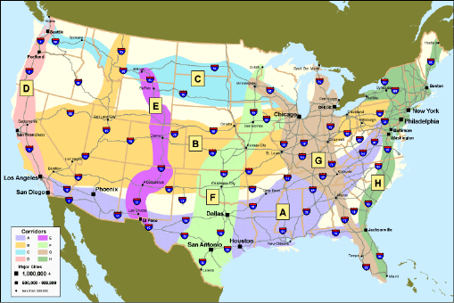
US DRUG CORRIDORS

Slide 6
DRUG TRAFFICKING
DRUGS ARE “SCHEDULED” BASED UPON THEIR ADDICICTIVE NATURE AND THEIR DANGEROUSNESS.
THERE ARE 7 SCHEDULES, WITH SCHEDULE 1 BEING THE MOST DANGEROUS.
OFFENSES ARE BASED UPON THE AMOUNTS OF A CERTAIN DRUG AND ITS SCHEDULE.

Slide 7
OFFENSES YOU MAY DEAL WITH
SALE & DELIVERY OF A CONTROLLED SUBSTANCE
PRESCRIPTION FRAUD
MONEY LAUNDERING
RACKETEERING INFLUENCED AND CORRUPT ORGANIZATIONS CRIMES
TAMPERING WITH EVIDENCE
CRIMINAL SIMULATION
SECOND DEGREE MURDER

Slide 8
WITNESSES
CITIZEN WITNESSES
LAW ENFORCEMENT OFFICERS
HEALTHCARE PROFESSIONALS
INFORMANTS
DRUG DEALERS
DRUG ADDICTS

Slide 9
OPIOID INITIATIVE
THREE BASIC COMPONENTS
PROSECUTION
EDUCATION/PREVENTION
TREATMENT

Slide 10
OPIOID INITIATIVE
Increased prosecution for dealers.
Our office will continue to punish those “street dealers” of opioids.
We will work with our federal partners as part of the Opioid Fraud and Abuse Detection Unit to be more effective in prosecutions.
Drug Task Force will begin to aggressively pursue health care providers who are illegally prescribing.

Slide 11
OPIOID INITIATIVE
Increased prosecution for dealers.
Empaneling a special investigatory grand jury.
Investigation of overdoses on a two track system of homicide/assault and drug transactions
Aggressive use of money laundering and RICO statutes

Slide 12
OPIOID INITIATIVE
PHARMA LIABILITY.
Joining with other District Attorneys General by seeking injunctions and civil damages from the pharmaceutical companies who have acted in violation of the law.
All four counties of the Tenth Judicial District will be covered in this litigation, and there will be no cost to any of our counties.
Lawsuit filed September 29, 2017

Slide 13
OPIOID INITIATIVE
COMMUNITY INVOLVEMENT
Our office will continue to work with our local partners such as THE BRIDGE and a create a coalition to educate and raise awareness of this problem.
Heighten public awareness of the dangers of opioids.
The long term key to winning this fight is to educate our children and prevent addiction in our middle and high schools. These organizations are key to our efforts.

Slide 14
OPIOID INITIATIVE
ADVISORY GROUP
Create an advisory panel of health care providers, educators, law enforcement and the public
Help us make good public policy and advocate
Help allocate prosecution resources.

Slide 15
OPIOID INITIATIVE
SEEK INCREASED TREATMENT
Our office will begin to advocate for and aggressively pursue funding options for more local treatment options.
We cannot rely on Nashville or Washington to make this happen. The people of the Tenth Judicial District can and will find a method and funding for more treatment.

Slide 16
TN TOGETHER
GOVENOR’S INITIATIVE
Prevention
Limit Prescriptions for new patients
Limits TennCare initial dosage
Education in schools
Modify medical training for doctors
Creates best practice group for pain management

Slide 17
TN TOGETHER
GOVENOR’S INITIATIVE
TREATMENT
$25 million for treatment and recovery
Improve data access for targeting resources
Increase naltrexone use
Incentives for offenders to complete treatment
Recovery courts

Slide 18
TN TOGETHER
GOVENOR’S INITIATIVE
LAW ENFORCEMENT
Additional TBI agents
Update controlled substances schedules
Provides THP with naloxone

Slide 19
OPIOID INITIATIVE
We need the help of local elected officials and the public. We need the public to care enough to work with us. We need students to care enough about classmates to prevent more tragic deaths. And we need the resolve to say that we will not sit by and simply allow this to happen.
Together, we can win this fight.

